Slide 1
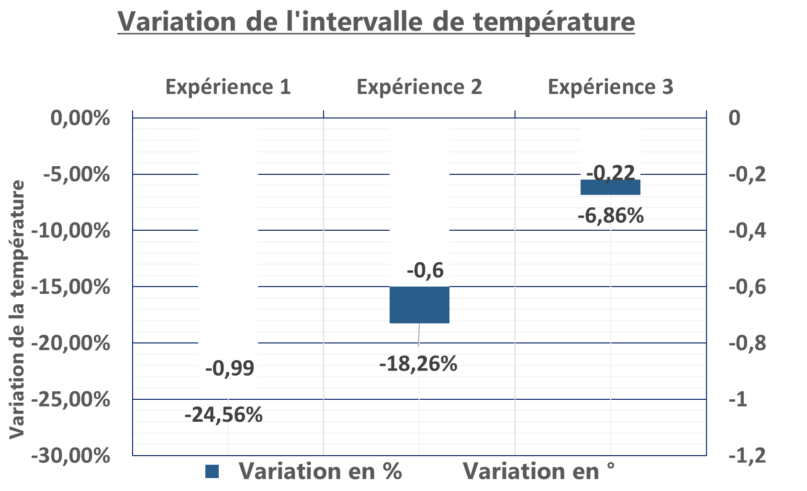
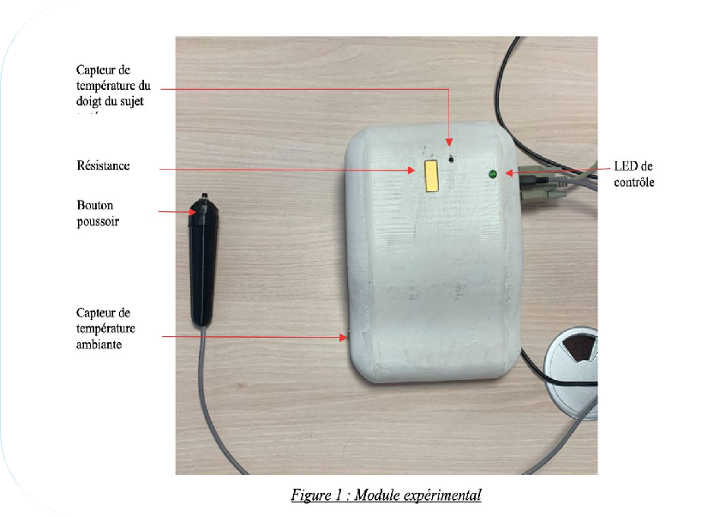
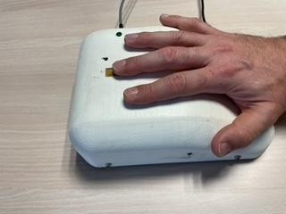
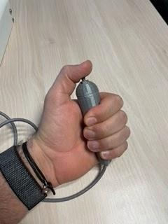
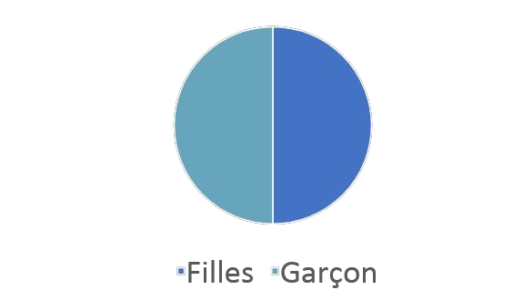
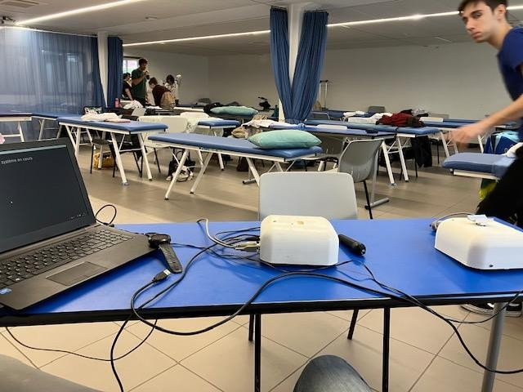
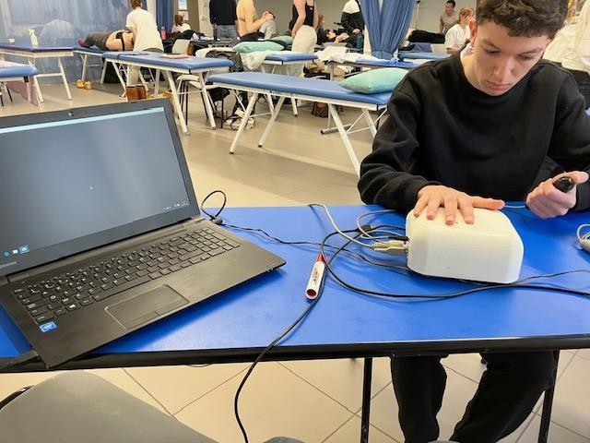
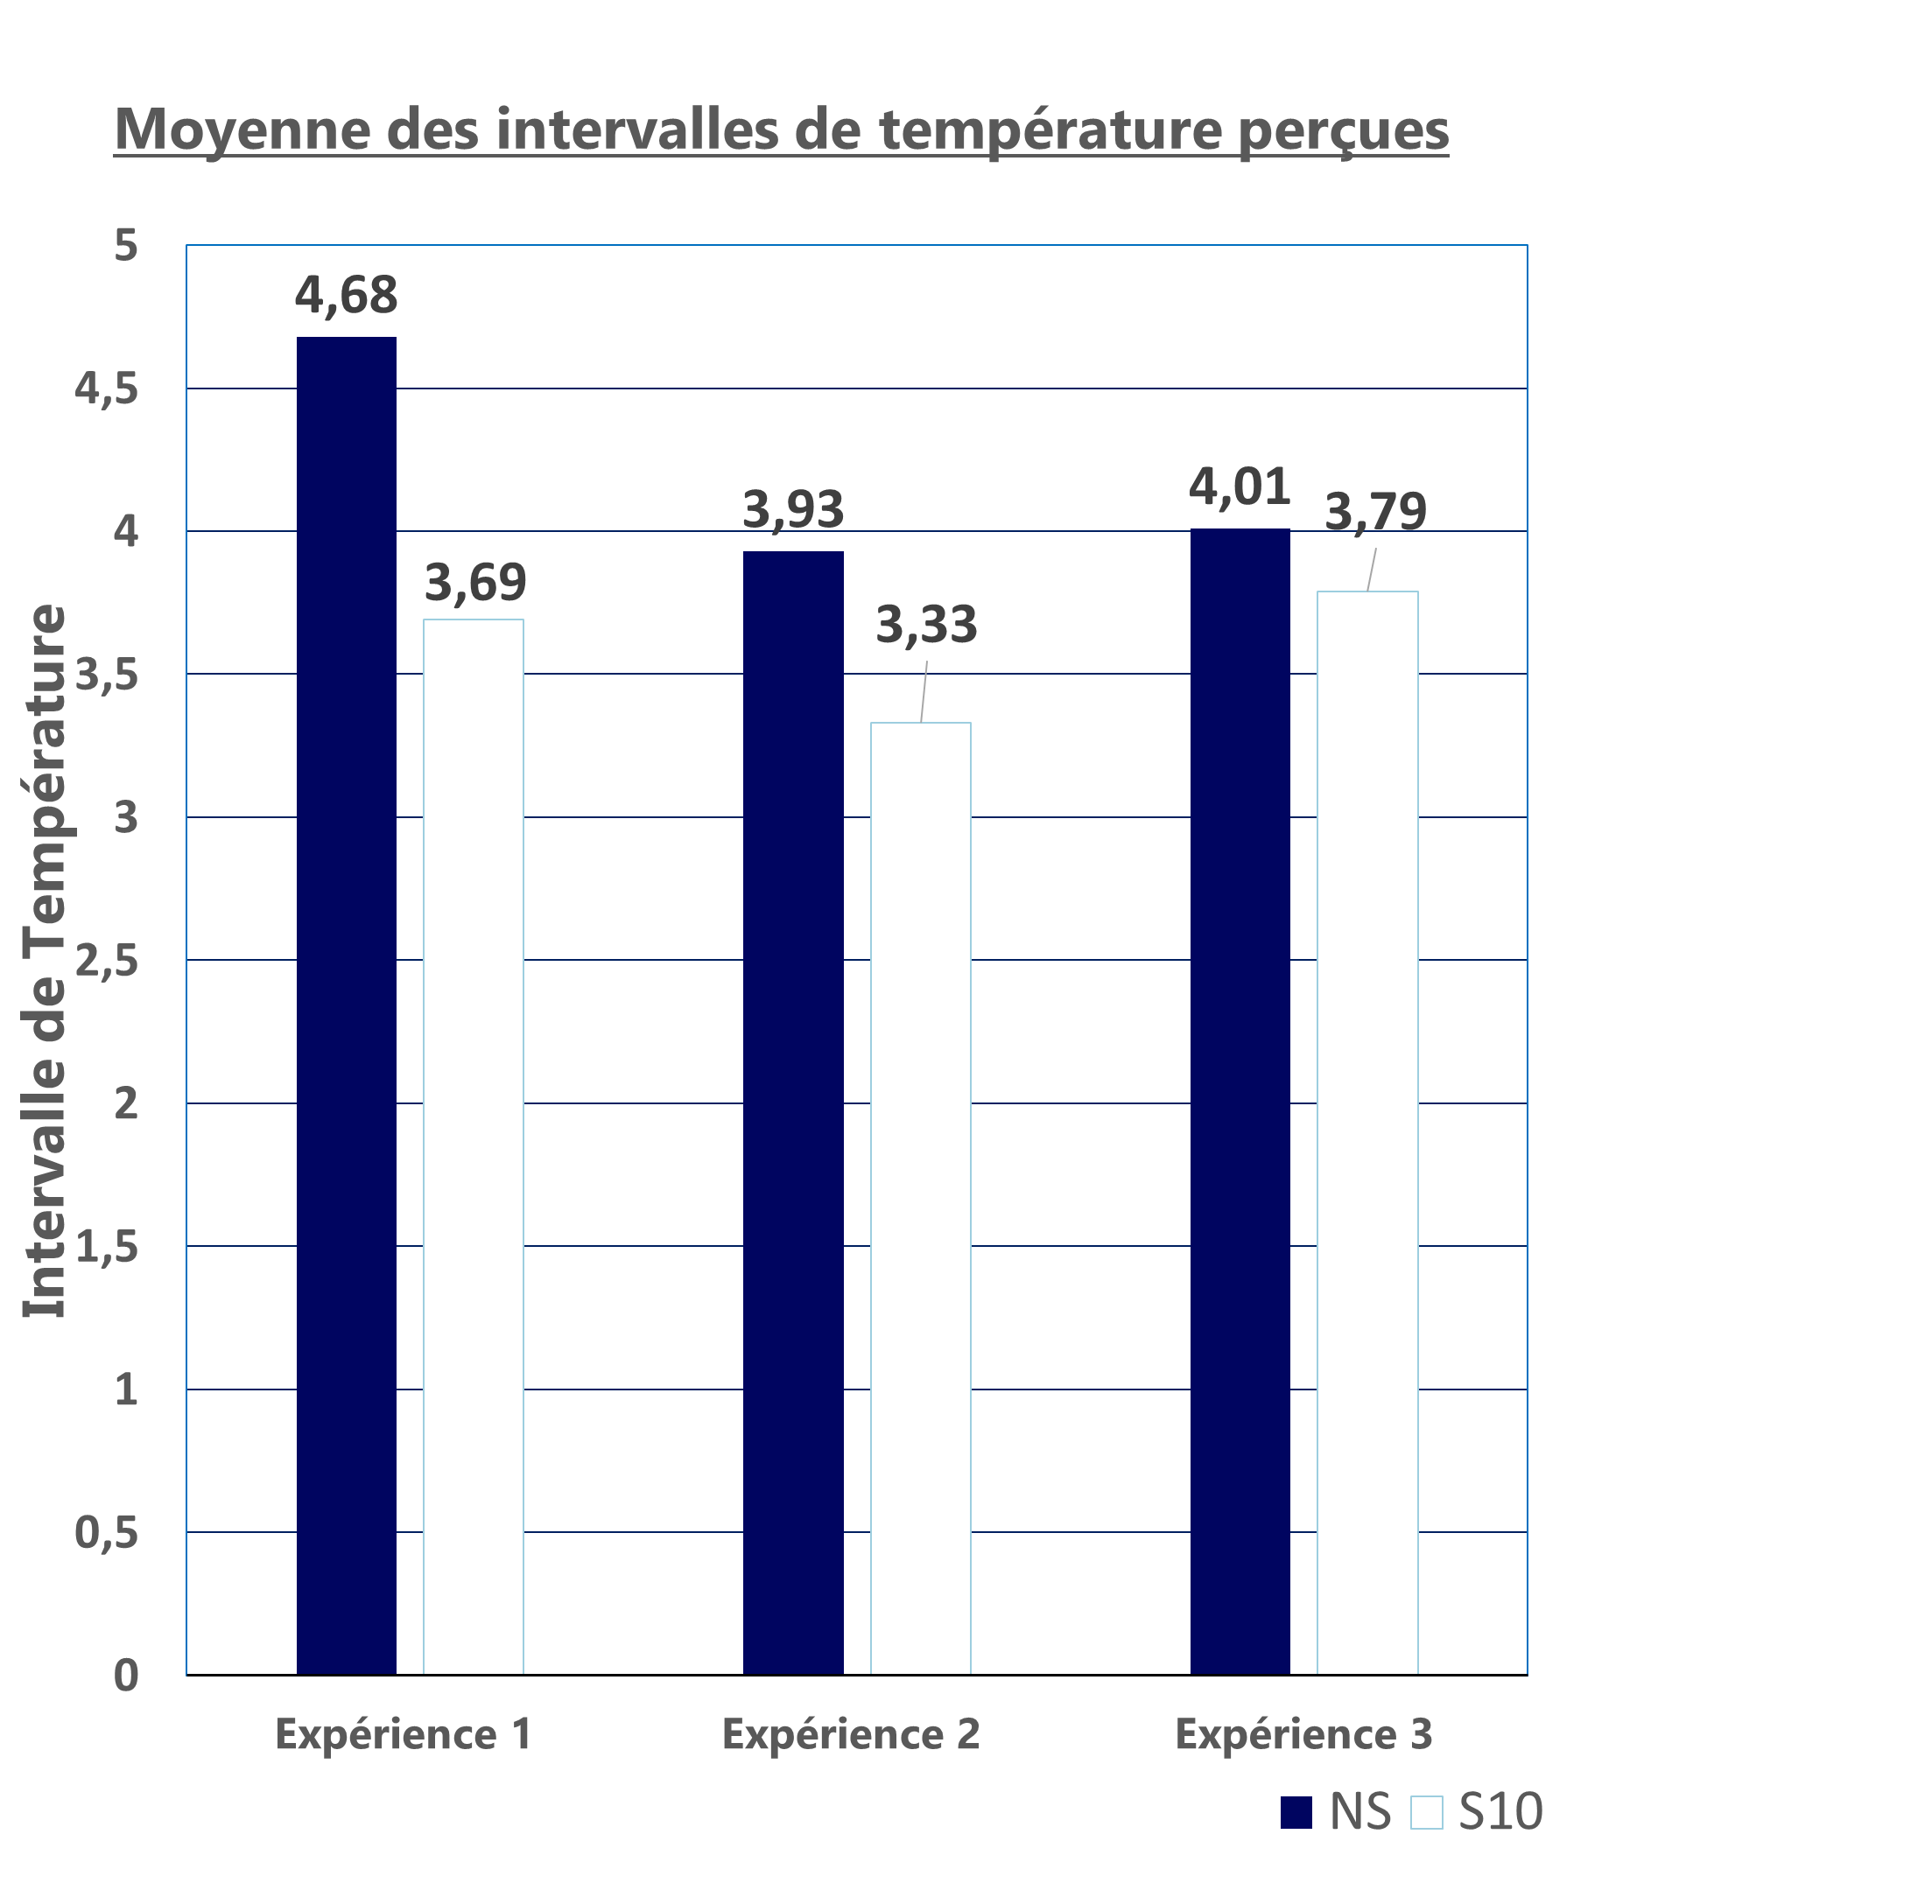
How do we know if our perception is right ?
C.Clouzeau*¹, M.Baret ¹, R.Jamon ¹, H.Rougon ¹, T.Sabatier ¹, L.Saccard ¹, R.Allard ², D.Navarro ³
*Référent cyril.clouzeau@gmail.com, 1 CEESO Lyon, 2 ISOstéo Lyon, 3 Ecole CENTRALE de Lyon
Osteopathic testing and diagnosis are based on the quality of manual perception.
This subjective, complex and multifactorial perception is difficult to assess for the student, who is looking for conformity with what is expected during his or her apprenticeship. How can we help ?
OBJECTIVE
This study proposes a self-assessment tool for one of the components of perception: thermal discrimination
1- Warming up the module
2- Positioning the student's index finger
3- The examiner launches the random temperature variation
4- The student presses the button when he feels the temperature change
5- 5 successive temperature variations are performed
6- Calculation of average detection and speed with tests 2, 3 and 4
MATERIAL AND METHOD
A module using the Peltier effect created by students at the Ecole Centrale de Lyon offers random temperature variation using a PT100 thermal probe.
From 2019 to 2021, 100 students tested the reliability and contributed to the technical evolutions of the module, which proposes, from a random initial temperature, a variation towards hot or cold of 0.1°C every 0.5 seconds until the student indicates perceiving a difference.
The recording lasts between 3 seconds and 3 minutes, depending on the student's response, in a room at 22-24°C.
The student follows the instructions on a computer screen, which prepares him or her with a countdown to 5 successive tests. Measurements 2,3,4 are recorded to calculate the average reaction time and the thermal detection threshold.
Tests 1 and 5 serve as a trial run, and are not included in the calculation.
In March 2023, 34 students (statistical significance threshold calculated) completed the study.
RÉSULTATS
The 2019 (n=60), 2021 (n=40), and 2023 (n=34) acquisitions made in osteopathic schools were statistically compared. The 34 results (2023) were significant: p < 0.032.
Osteopathic students detect a mean temperature variation of 1.2°C for temperatures between 17°C and 34°C. (+/- 1.2 ° C (DS +/- 0.6)
Over 3 years of practice, the detection threshold is lowered by 0.3°C, but this does not mean that the student "gains" 0.1 degrees per year, as results are so heterogeneous.
Take Home Message
The pilot experiment demonstrates the value of a tool that objectifies the discriminating power of the student's thermal perception, allowing them to self-assess whether their perception is evolving during their osteopathic studies.
To avoid the learning effect, an annual self-assessment over the 5 years of osteopathic studies would reinforce the feeling of progress and accuracy, beneficial to the student without subjecting him or her to the judgment of a teacher.
Physiological sensory data are not sufficient to explain the perception developed in osteopathy, but the measurement and evolution of the thermal detection threshold provides an insight into its discriminating power.

